Slide 1
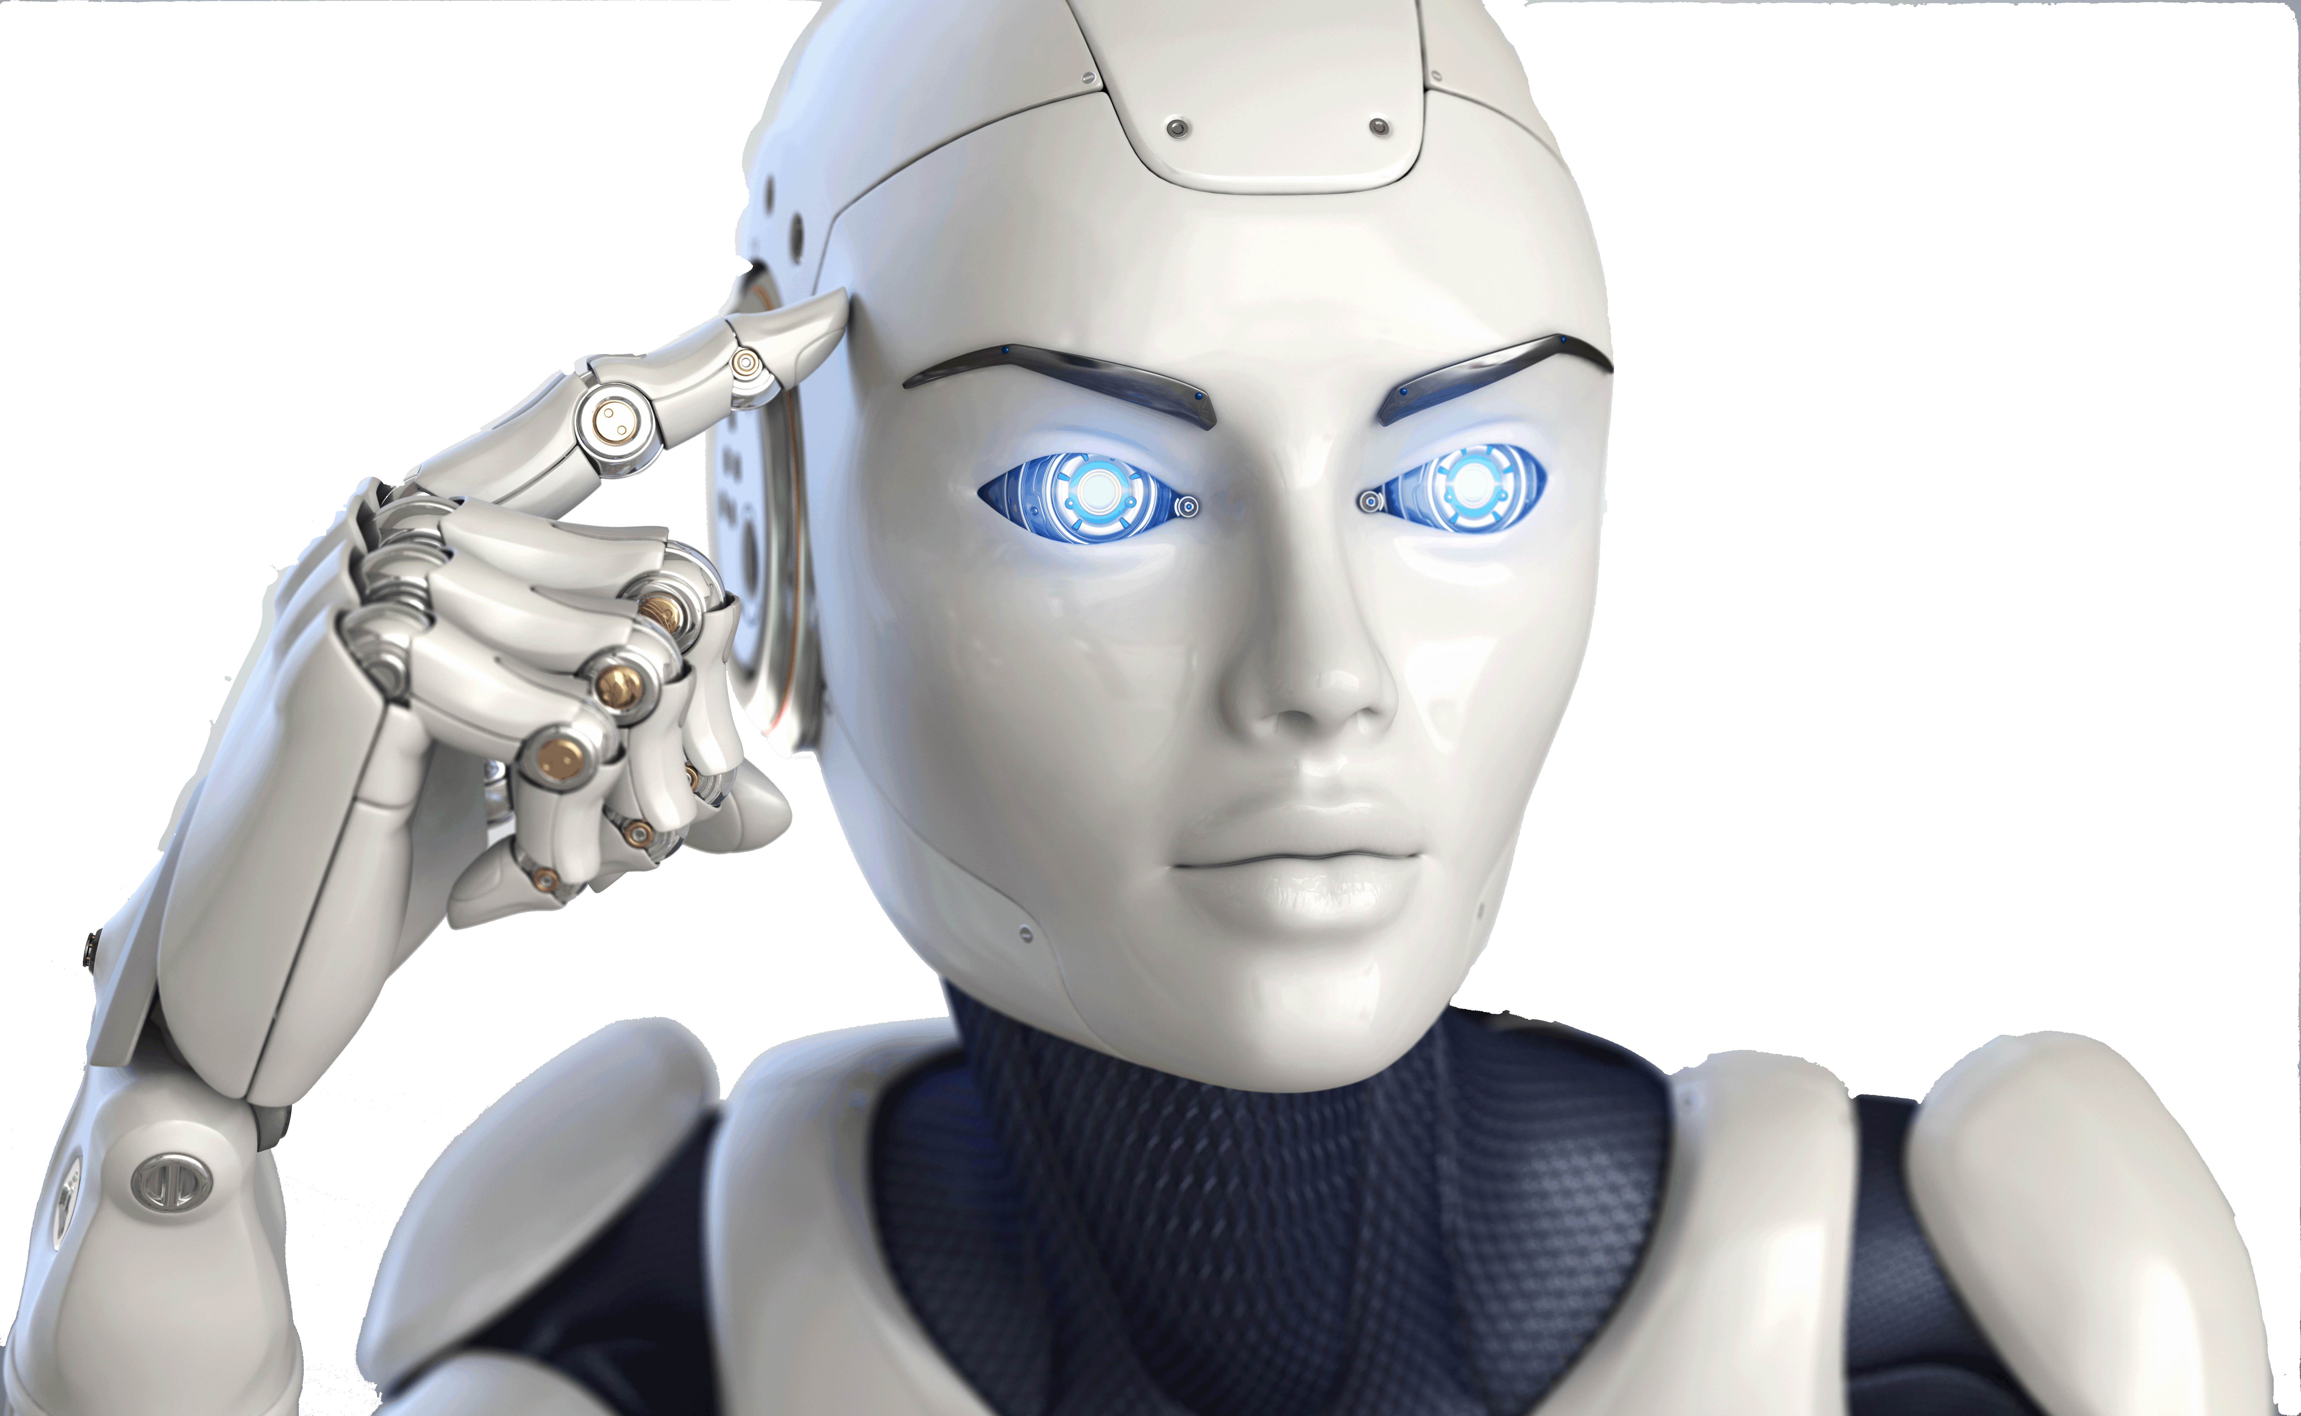
Brain Simulator II
From:
Future AI
http://FutureAI.guru

